Slide 1
Large-Scale and Multi-Structured Databases Project Design Manga Universe
Flavio Messina
Feyzan Çolak
Noemi Cherchi

Slide 2

Application Highlights
Application allows user to:
Browse and Search Mangas using some filters
Review Mangas (Only the Customers) and See the Review of Other Customers
See Detailed Information of Manga
Profile Managament
Create and Manage Personal Lists of Manga (Only the Customers)
Following Customers (Only the Customers) and See Their Actions
See Analytics of Mangas (Only the Managers)

Slide 3
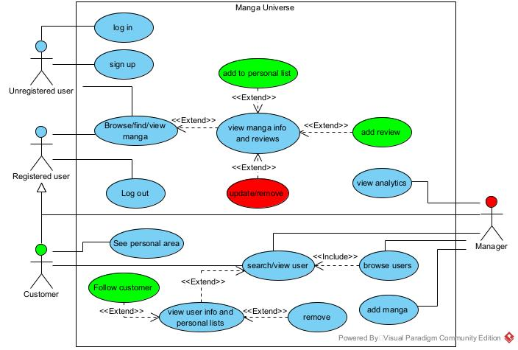
Actors and main supported functionalities

Slide 4
Dataset Description
Source:
Description:
Volume:
Variety:
Velocity/Variability:

Slide 5
Preliminary UML Class Diagram

Slide 6
Requirements and Entities handled by Document DB

Slide 7
Requirements and Entities handled by Key-Value DB

Slide 8
Requirements and Entities handled by Graph DB

Slide 9
Software Architecture Preliminary Idea
Include also the frameworks and tools that the group would like to use (programming languages, DBMSs, etc..)

